Slide 1
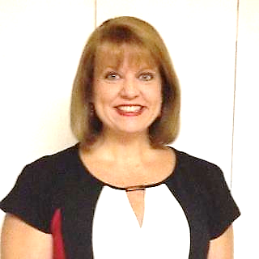
Dr. Andrea Oliver
Professor, History
Susan Wessner
Professor,
Developmental Mathematics

Slide 2
What is S.O.A.R.(Success Over All Restrictions)?
By: Andrea Oliver and Susan Wessner
A 3-week summer program designed to provide enrichment in math for middle school students attending Title One Schools in the 32304, 32305 & 32310 zip codes.
Program Offerings:
Math Enrichment
Study Skills
College/Career Readiness

Slide 3
S.O.A.R. Success Over All Restrictions - Rationale
In response to the COVID 19 pandemic of Spring 2020, s
In response to the COVID 19 pandemic of Spring 2020, schools nationwide shifted instruction to online, remote learning settings affecting 55 million students. instruction to online, remote learning settings affecting 55 million students.
Experts advise that the typical learning loss for students already performing below grade level already places them at an educational disadvantage that will only be more profound because of the unprecedented learning disruptions that occurred in the wake of school closures.te wake of school closures.

Slide 4
S.O.A.R. Success Over All Restrictions - Rationale
According to an Edutopia article from May 2020, experts believe that learning loss for these students will occur at rates between 32 - 37% in reading and rates between 37 - 50% in math.
Tallahassee Community College is uniquely positioned to direct institutional resources to address an issue affecting the families in the communities we serve by offering an intensive program in academic support and enrichment.

Slide 5
Our Timeline…
January: Project Start
February – March: Camp Permission and Site Approval
April – May: Contact Participant Schools and Marketing
May – June: Participant Identification and Pre-Assessments – Currently Ongoing
June 14 – July 6: Program Launch & Operation; Post Assessment & Evaluation

Slide 6
S.O.A.R. Success Over All Restrictions: Expected Outcomes
To realize measurable gains in math competencies as determined by program assessments as indicated by pre- and post- assessment surveys.
To market TCC as a top choice for post-secondary education to students in our service district indicated by post program survey measuring intent to enroll at TCC.
To provide a safe, academically enriched alternative for summer break to an underserved population (youths ages 11 – 14) as indicated by a program attendance/retention of 70% or greater.
Participant Incentives
Free Meals – Summer Food Site in Partnership with Second Harvest
Mentorship
Small Class – Tailored Instruction
Completion Ceremony
Walmart Gift Cards

