Slide 1
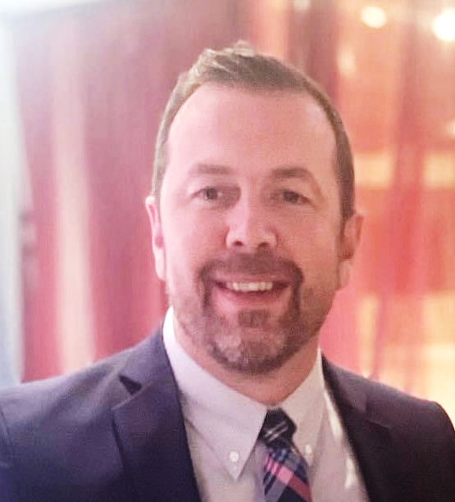
Dustin Frost
Director, Procurement and Auxiliary Services

Slide 2
Capstone Focus
Capstone Overview
Project Description:
Implement a training program that specializes in all things purchasing related. Emphasis was placed on bringing awareness to the rules and regulations of Tallahassee Community College, the State of Florida, and Federal purchasing guidelines. Additional emphasis was placed on Workday business processes.
Rationale (the WHY):
When employees have access to resources and training they will be able to:
Make sound purchasing decisions that follow all necessary guidelines.
Understand the entire purchasing process from start to finish more confidently, efficiently, and correctly.
In the end this assures that the College is being a responsible financial steward.

Slide 3
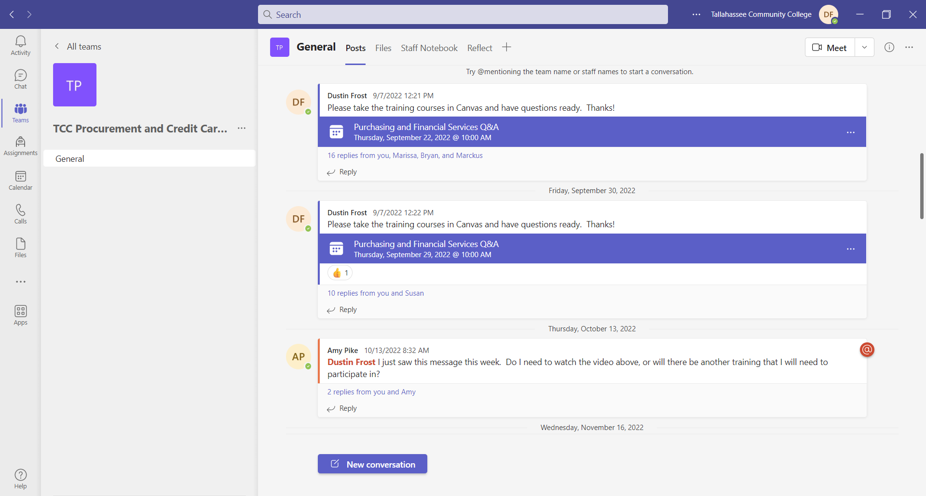
Capstone Results
The Plan
Develop Canvas Training Module
Create Microsoft Teams Group/Email Listserv for communications
Hold monthly or every other month Q&A/Town Hall meeting via Teams
Provide In-person Departmental Training on request
Provide specialized Training on Punchout Suppliers
Results
70% have taken Canvas Training
6 Q&A/Town Halls Sessions avg 50-60 attendees
1 in-person Departmental Training, 2 scheduled, 1 requested but not scheduled yet
3 specialized trainings for Punchout, additional forthcoming
Notes:
Developed Procurement Training in Canvas-267 students and 70% have used the training (Sept). Add users as they are added to security group or upon request
4 Modules
Purchasing 101- went over different types of requisitions, thresholds, exemptions, How to create that included screen shots, receipting and change orders
TCC Credit card Program- brief description of types of cards, spend limits, responsibilities, best practices., things we can and cant purchase How to request in Workday
Expense Card & Travel- since this is our travel card correlates to travel. Went over rules of traveling ,spend authorizations, expense reports. Had to update when workday changes to Expenses Hub
Procurement card- step by step on how to verifying procurement card transactions.
Monthly Q&A
Held 6 Town Halls since September 15th. Average 50-70 participants
Usually concentrate on 1-2 specific topics and then open it up to Q&A.
Wanted it to be interactive and time well spent
In-Person Training
Student Services
FPSI and DOC employees on schedule
Request from Institutional Effectiveness
Specialized Training
Moved Amazon to Punchout and held two training in October. Oct 20th and Oct 24
Konica Minolta transition plan

Slide 4
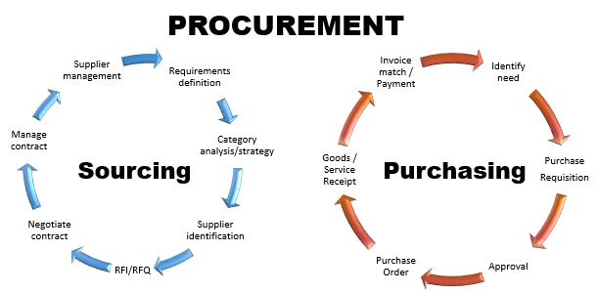
SUGGESTIONS FOR FURTHER RESEARCH
Suggestions for the Future
Continue to update current Canvas Procurement training
Add additional Canvas Procurement training modules
Send out an end-of-year survey to Teams group
Work with Business Analysts to capture data on business process steps
Require 100% participation in Canvas training
Notes:
Update/Add- as College, state and federal policies change we will need to change the training. Also, as Workday has updates we will need to update as well.
Survey- work with IE to create a survey to gage the effectiveness of the training. We want this training to be effective and beneficial to the users.
BA-Currently there is not way to collect data on the effectiveness of the training, are there less “send backs” See if we can develop a report that shows when the requisition process is sent back for correction. Then we can begin to develop baseline data and compare. If its sent back for correction this is wasted time and resources, which cost the College money.
100%- at minimum you should be required to take the procurement training in Canvas or lose your credit card/purchasing rights.

