Slide 1
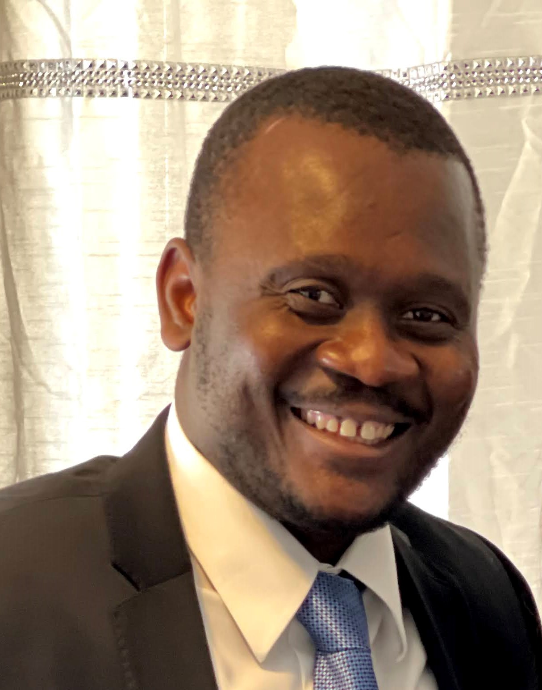
Johnny Petit
Assistant Professor,
Division of Science and Mathematics

Slide 2
Capstone Focus
Capstone Overview
Project Description:
Competitive Edge Program
Recruit engaged and successful PTK/Honors students to serve as peer mentors/tutors to FTIC students in the Eagles Rise and Sister to Sister programs. Competitive Edge leaders will earn service hours and must successfully pass training to serve as peer mentors/tutors.
Rationale (the WHY):
The goal of this project is to help reduce the equity gap by testing the relationship between peer-to-peer mentoring/tutoring and FTIC students’ success.
Johnson and Stage (2018) reveal that service-learning, community engagement, and capstone projects are positively correlated to student success.
Arco-Tirado et al. (2020) demonstrated that peer-to-peer mentoring programs positively impact FTIC students’ performance.
Hong et al. (2021) suggested that leadership engagement, community involvement, and a sense of purpose are positively correlated to student success.

